Slide 1
[IBSVN]_[Knowledge sharing for developing environment]_[Part1]
April, 2015
Intelligence Business Solutions Vietnam Co., Ltd.

Slide 2
Knowledge sharing for developing environment
1. Purpose
Now a day, many language for development. When developer make demo for customer understand or make demo for presentation. We couldn’t built it on real environment.
We find some way to do it.
As my understanding I found some way to do that thing. However it limit by my knowledge.
That’s why, I was thinking online IDEs.
No wonder beginning coders are increasingly turning to online integrated development environments (IDEs).
An online IDE is a code editor that comes ready to work with languages and all their dependencies, saving you the hassle of installing them on your computer.
I wanted to learn more about what constitutes the typical online IDE, so I took a look at the free tier for three of the most popular cloud-based integrated development environments out there:
  Cloud9
  Koding
  Nitrous.IO.
In the process, I learned a lot about the cases in which programmers would and would not want to use IDEs.

Slide 3
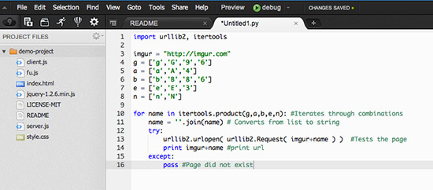
Knowledge sharing for developing environment
2. Why Use An Online IDE?
If a text editor is like Microsoft Word, think of a cloud-based IDE as Google Drive. You get similar functionality, but it's accessible from any computer and ready to share. As the Internet becomes an increasingly influential part of project workflow, online IDEs make life easier.
In here, I have example on Nitrous.IO for tutorial, the Python app in Simple Messaging App(*). When you use an online IDE, you select the language you want to work in so you can test and preview how it looks on the IDE’s Virtual Machine (VM) designed to run programs written specifically in that language.
(*) http://readwrite.com/2014/07/11/one-click-messaging-app

Slide 4
Knowledge sharing for developing environment
3. What An Online IDE Is Not
Still, a cloud-based IDE is not a long term hosting solution.
When you’re working on an IDE, you’re able to build, test and preview your app in the cloud. You’re even able to share the final draft via link.
But you can’t use an IDE to store your project permanently. You wouldn't ditch your blog in favor of hosting your posts as Google Drive documents. Like Google Drive, IDEs allow you to link and share content, but neither are equipped to replace real hosting.
What's more, IDEs aren't designed for wide-spread sharing. Despite the increased functionality IDEs add to the preview capability of most text editors, stick with showing off your app preview to friends and coworkers, not with, say, the front page of Hacker News. In that case, your IDE would probably shut you down for excessive traffic.
Think of it this way: an IDE is a place to build and test your app; a host is a place for it to live. So once you’ve finalized your app, you’ll want to deploy it on a cloud-based service that lets you host apps long term, preferably one with a free hosting option like Heroku.
(*) http://readwrite.com/2014/07/11/one-click-messaging-app

Slide 5
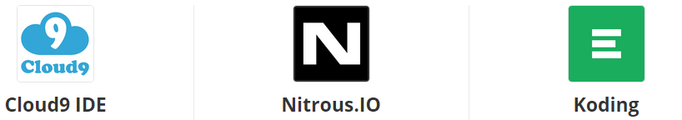
Knowledge sharing for developing environment
4. Choosing An Online IDE
As IDEs become more popular, more are popping up all the time. In my opinion, there’s no perfect IDE. However, some IDEs are better for certain work process priorities than others.
I took a look at the free tier for three of the most popular integrated development environments out there: Cloud9, Koding, and Nitrous.IO. Each has its benefits, depending on what you're working on.
Here's what I found.

Slide 6

Knowledge sharing for developing environment
4. Choosing An Online IDE
Cloud9: Ready To Collaborate
  When we signed up for Cloud9, one of the first things it prompted our to do was integrate my GitHub and BitBucket accounts. Instantly, all my GitHub projects, solo and collaborative, were ready to clone and work on in Cloud9’s development tool. Other IDEs have nowhere near this level of GitHub integration.
  Out of the three IDEs I looked at, Cloud9 seemed most intent on ensuring an environment where I could work seamlessly with co-coders. In fact, Cloud9 collaborators can see each others coding in real time.
  “Most services’ collaborative features only work on a single file”. “Ours work on multiples throughout the project. Collaboration is fully integrated within the IDE.”
In summary
  Cloud API’s will help us scale
  Having your code in the cloud makes it easier to access, collaborate and maintain.
  Integration enables easy targeting of plantom.

Slide 7

Knowledge sharing for developing environment
4. Choosing An Online IDE
Koding: Help When You Need It
  IDEs give you the tools you need to build and test applications in the gamut of open source languages. For a beginner, that can be a little bit intimidating. For example, if You’re working on a project with both Python and Ruby components, which VM do I use for testing?
  The answer is both, though on a free account, you can only turn on one VM for testing at a time. I was able to find that out right on my Koding dashboard, which doubles as a place for users to give and get advice on their Koding projects. Of the three, it’s the most transparent when it comes to where you can ask for assistance and hear back in minutes.
  “We have an active community built into the application”. “We wanted to create an environment that is extremely attractive to people who need help and who want to help.”
※We can get more understanding at
http://www.slant.co/topics/713/viewpoints/17/~what-is-the-best-cloud-ide~koding

Slide 8
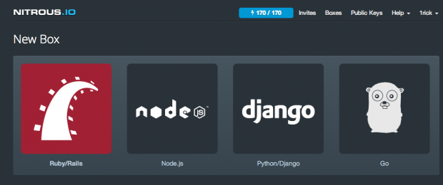
Knowledge sharing for developing environment
4. Choosing An Online IDE
Nitrous.IO: An IDE Wherever You Want
  The ultimate advantage of using an IDE over your own desktop environment is that it’s self-contained. You don’t have to install anything to use it. On the other hand, the ultimate advantage of using your own desktop environment is that you can work locally, even without Internet.
  Nitrous.IO gives you the best of both worlds. You can use the IDE on the Web, or you can download it to your own computer. The advantage is that you can merge the integrations of Nitrous with the familiarity of your preferred text editor.
  “You can access Nitrous.IO from any modern web browser via our online Web IDE, but we also have handy desktop applications for Windows and Mac that let you edit with your favorite editor”.
※We can get more understanding at
http://www.slant.co/topics/713/viewpoints/16/~what-is-the-best-cloud-ide~nitrous

Slide 9
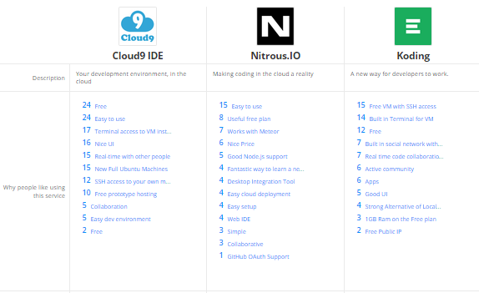
Knowledge sharing for developing environment
4. Choosing An Online IDE
Cloud9 IDE vs. Nitrous.IO vs. Koding

Slide 10
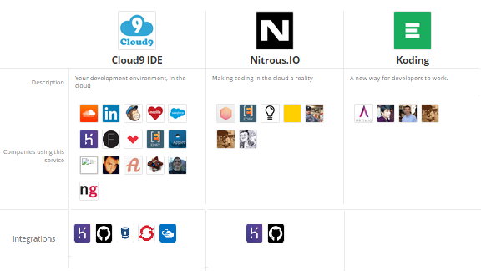
Knowledge sharing for developing environment
4. Choosing An Online IDE
Cloud9 IDE vs. Nitrous.IO vs. Koding

Slide 11
Knowledge sharing for developing environment
5. The Bottom Line
Cloud9, Koding, and Nitrous.IO all support every major open source language, from Ruby to Python to PHP to HTML5. You can choose from any of those VMs.
Both Cloud9 and Nitrous.IO have built-in one-click GitHub integration. For Koding there are a couple more steps, but it can be done.
Each integrated easily with the APIs we needed. Each let our install our preferred package installers, too (and Koding made me do it as a superuser). They all have a built in Terminal for easily testing and deploying projects. All three allow you to easily preview your project. And of course, they all hosted our project in the cloud so We could work on it anywhere.
On the downside, they all had the same negatives, which is reasonable when you consider they're free. You can only run one VM at a time to test a program written in a particular language. When you’re not using your VM for a while, the IDE preserves bandwidth by putting it into hibernation and you have to wait for it to reload next time you use it (and Cloud9 was especially laborious). None of them make a good permanent host for your finished projects.
※So to answer those who ask me if there’s a perfect free IDE out there, probably not. But depending on your priorities, there might be one that’s perfect for your project.
If have good feedback from yours, Next time I will prepare part2 to explain more detail how to user them(Online IDEs)
Of course this document only basic from my opinion. If have any mistaken, Please ignore it.

Slide 12
Knowledge sharing for developing environment
6. Reference
https://c9.io/
https://koding.com/
https://www.nitrous.io/
http://stackshare.io/stackups/cloud9-ide-vs-koding-vs-nitrous-io#
http://www.slant.co/topics/713/viewpoints/1/~what-is-the-best-cloud-ide~cloud9
http://www.slant.co/topics/713/viewpoints/17/~what-is-the-best-cloud-ide~koding
http://www.slant.co/topics/713/viewpoints/16/~what-is-the-best-cloud-ide~nitrous

Slide 13
EOF
THANK YOU

